Slide 1
Movie Recommendation System Using Opinion Mining And Analysis
Cloud Computing Project
Vikas Patel (1141148)
Batch - GDL (102939)
Email: patelv175@lakeheadu.ca
Tirth Patel (1143729)
Batch - GDL (102939)
Email: tpatel16@lakeheadu.ca
Madhavi Patel (1147984)
Batch - GDL (102939)
Email: mpatel79@lakeheadu.ca
Priyank Kumar Patel (1150518)
Batch - GDK (102938)
Email: ppatel92@lakeheadu.ca

Slide 2
Table of Contents
NO. | TITLE
1 | INTRODUCTION
2 | PROBLEM DEFINITION
4 | THE PROPOSED MEDTHOD
5 | INDIVIDUAL TASK
6 | IMPLEMENTATION AND DEVELOPMENT
7 | RESULTS
8 | CONCLUSION
 | THANK YOU

Slide 3
Introduction
Use of digital entertainment is on pick nowadays. People prefer to watch movies and tv series on Online platforms such as Netflix, Prime Video, Hotstar etc.
Users express their sentiments more transparently in online reviews after watching those content.
Data received from these reviews permits companies to realize what makes customers cheerful or disappointed.
Using these reviews getting insights and working on them administration can address to client’s issue easily.
Recommendation System is mostly used in digital entertainment, such as Netflix, Prime Video, and IMDB, and e-commerce portals such as Amazon, Flipkart, and eBay.

Slide 4
Problem Definition
Based on the previous reviews by customers Recommendation of new content to users is utmost priority for digital entertainment.
The foremost requisite for a movie Recommendation system is that it must provide the users with the recommendation of movies that are resembling their preferences.
Our goal is to analyze user reviews and recommend new movies based on the prediction.
The system selects a random user and gives recommendations based on his/her previous movie history.

Slide 5
The proposed method
In this project, we learn Amazon Personalize which helps us to create real-time personalized movie recommendations in AWS.
Amazon Personalize is a fully managed machine learning service that enables developers to build customized recommendation systems.
We can build, train, and deploy Amazon Personalize recommendation model (a solution version) with the AWS Management Console or programmatically by using the AWS SDK for Python.
We use the AWS SDK for Python (Boto3) to create, configure, and manage AWS services, such as Amazon Elastic Compute Cloud (Amazon EC2) and Amazon Simple Storage Service (Amazon S3).
The SDK provides an object-oriented API as well as low-level access to AWS services.

Slide 6
Continue...
Major steps are:
Format input data and upload the data into an Amazon S3 bucket or send real-time event data.
Select a training recipe (algorithm) to use on the data.
Train a model (called a solution version in Amazon Personalize) using the recipe.
Deploy a campaign to make real-time recommendations or a batch processing job for batch recommendations.

Slide 7
Individual Task
We distributed our project majorly in 5 parts
Background and setup : Vikas
Configure and prepare dataset : Tirth/Vikas
Preprocessing Dataset : Tirth
Create and evaluate a solution : Madhavi/Priyank
Create a campaign and get recommendations for users : Madhavi/Priyank
However, We perform this project as a group project and help each other in their individual roles.

Slide 8
Implementation and Development Background and Setup
We used Amazon Personalize to train a solution for movie title recommendations and used the AWS SDK for Python to prepare the data.
We created a solution and campaign and deployed the recommendation model in Amazon Personalize.
To make recommendations, Amazon Personalize uses a machine learning model that is trained with our data.
The data used to train the model is stored in related datasets in a dataset group.
Each model is trained by using a recipe that contains an algorithm for a specific use case.

Slide 9
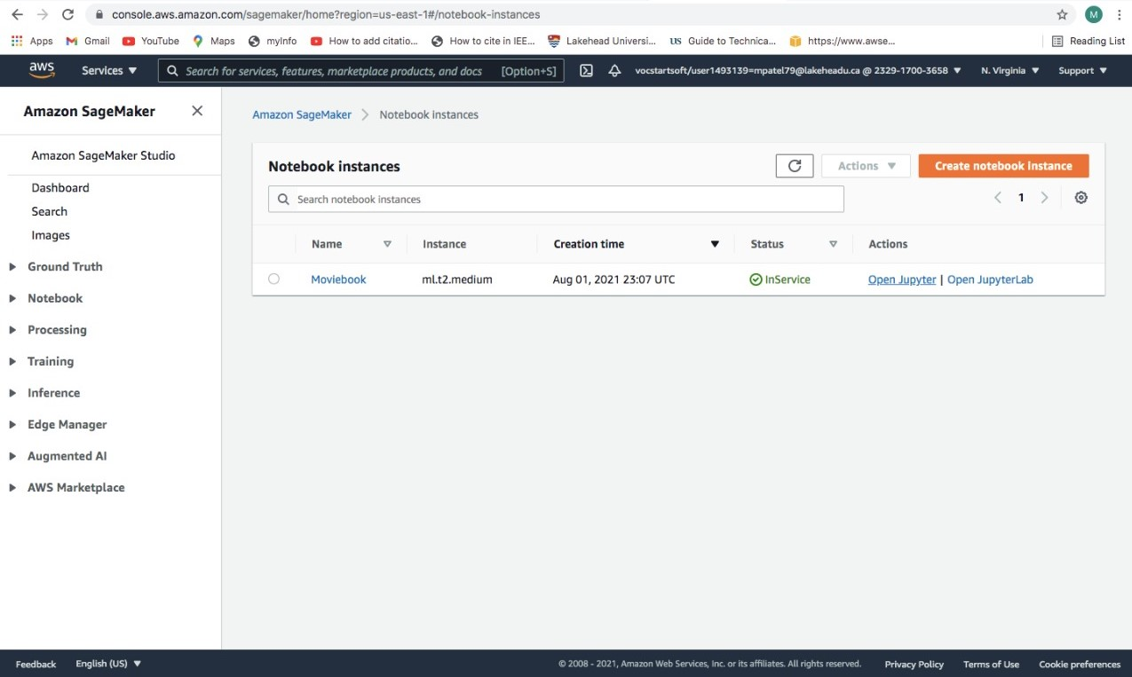
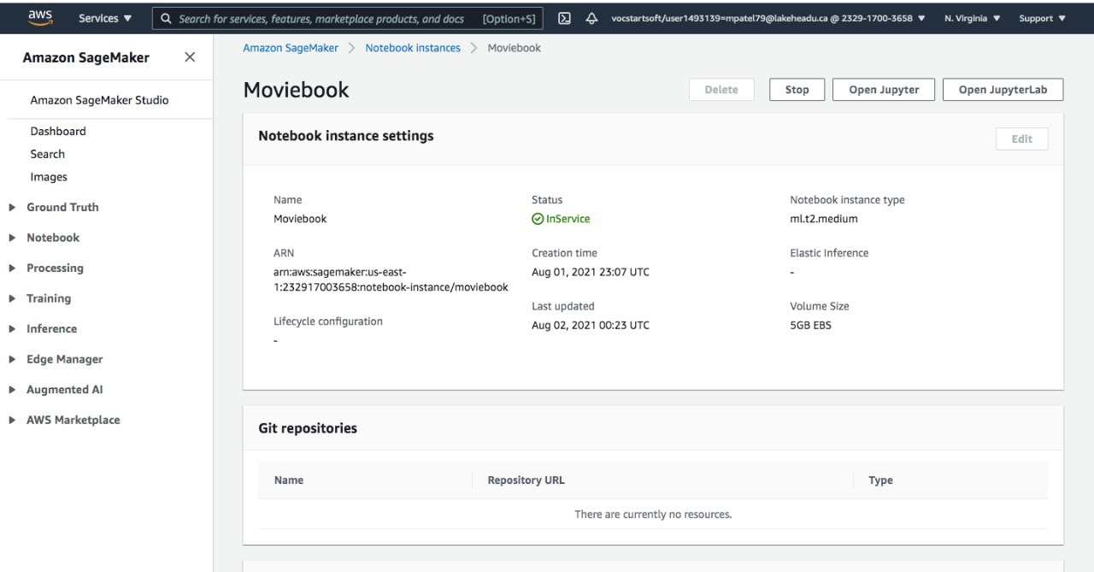
In Module 1 we have created an Amazon SageMaker notebook instance and attach the appropriate policies required in this lab for our SageMaker role. Finally, we create the Jupyter notebook and save it as our project name.

Slide 10
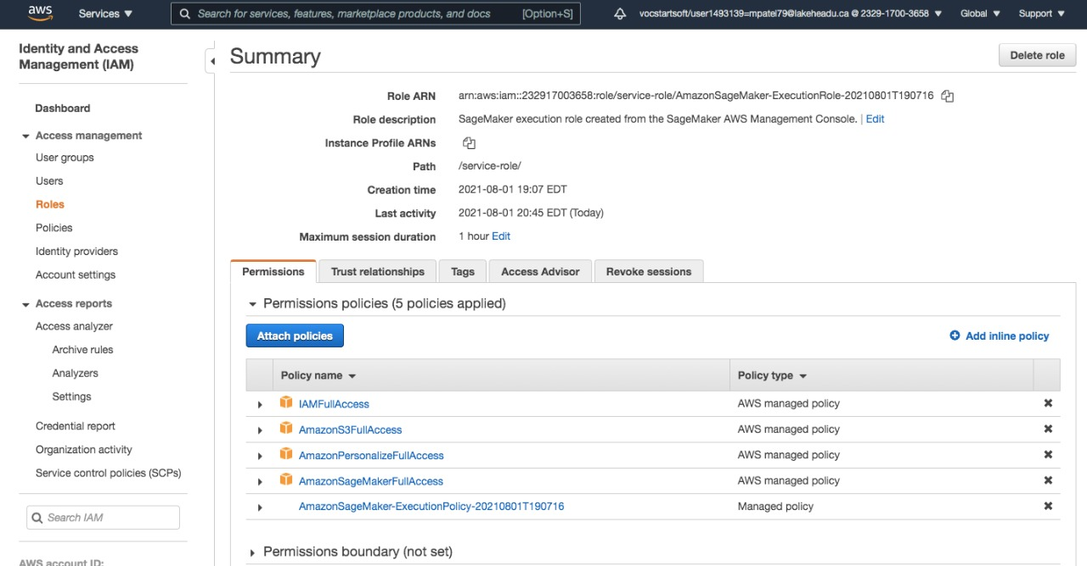
Attaching Policies to Notebook Instance

Slide 11
Download and Prepare dataset
Our Amazon Personalize model is trained on the MovieLens Latest Small dataset that contains 100,000 ratings and 3,600 tag applications applied to 9,000 movies by 600 users.
The MovieLens dataset is curated by GroupLens Research.
Dataset stores historical and real-time data from interactions between users and items.
This data can include impressions data and contextual metadata on your users’ browsing context, such as their location or device (mobile, tablet, desktop, and so on).
In this part, we downloaded our dataset, inspected the dataset, then created the dataset group and schema for this project.
Database Description: Small: 100,000 ratings and 3,600 tag applications applied to 9,000 movies by 600 users.
Last updated 9/2018.
Features : userId, movieId, rating, timestamp, imdbid, tag, userid, titles, genres
README.html; ml-latest-small.zip (size: 1 MB)

Slide 12
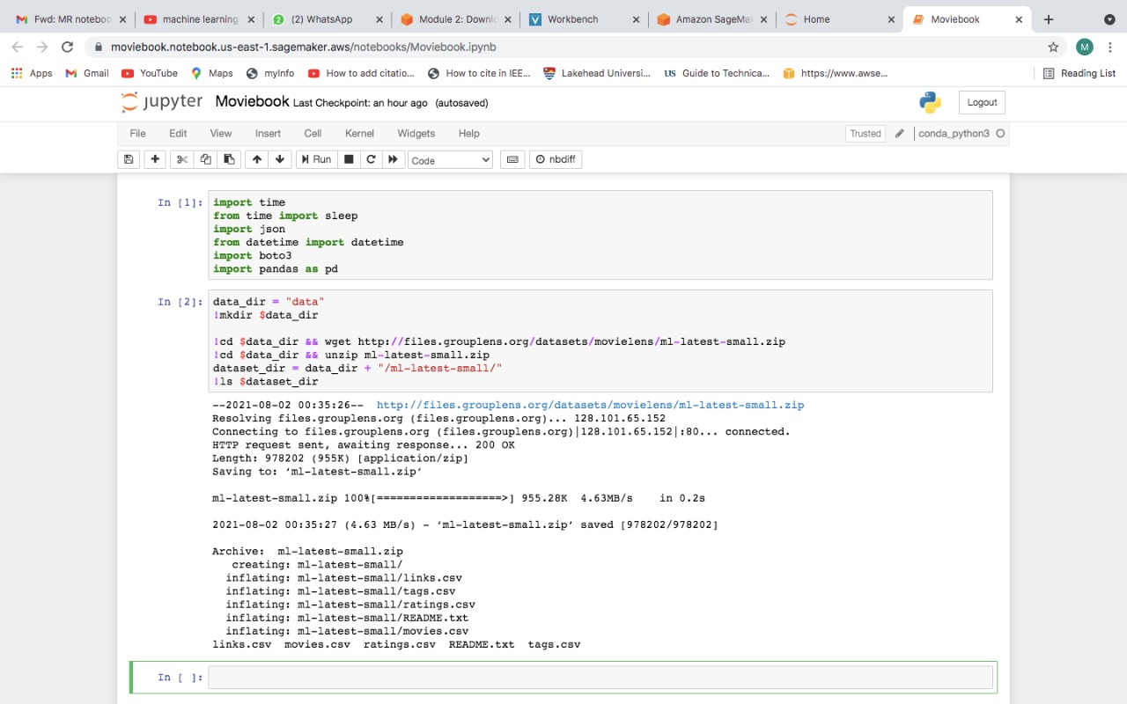
Here we have import some libraries and fetch the dataset.

Slide 13
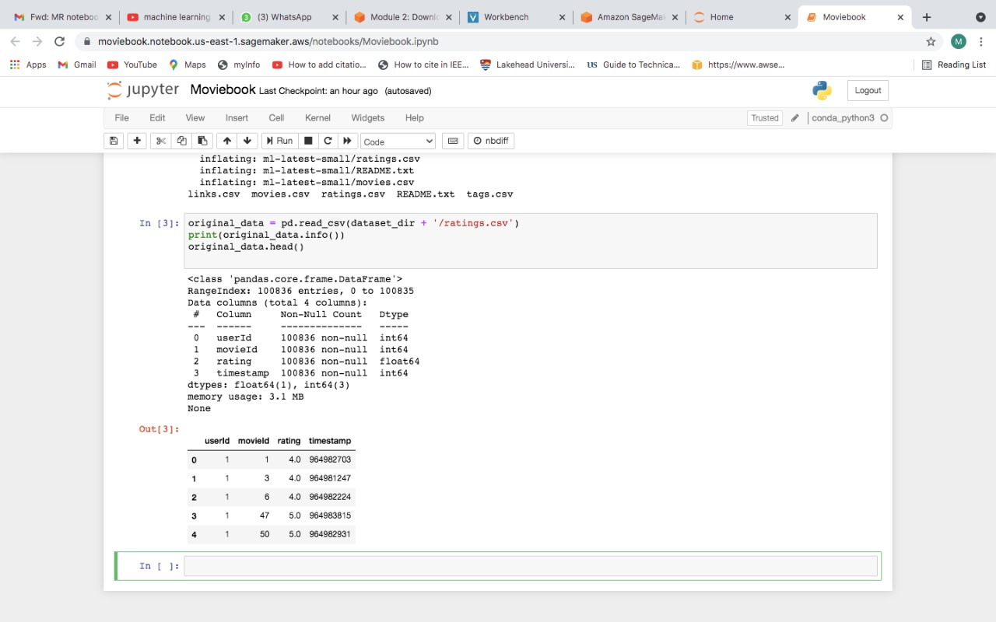
In this step, we defined two variables in the dataset to filter out unliked movies and better simulate data gathered by a video-on-demand (VOD) platform.

Slide 14
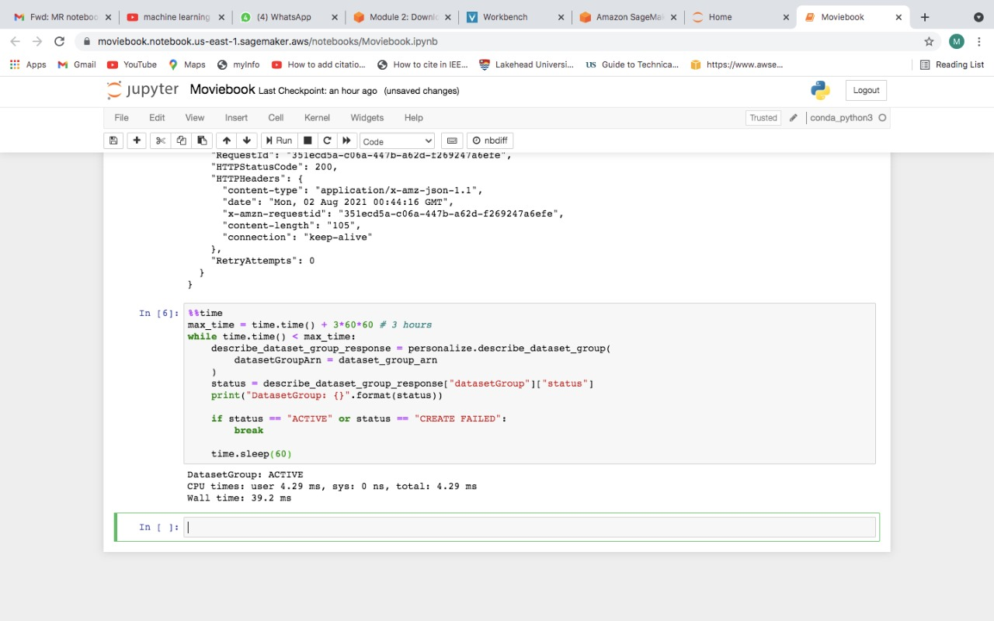
Finally, we created the dataset group, schema, and interactions dataset that is used to train Amazon Personalize model.

Slide 15
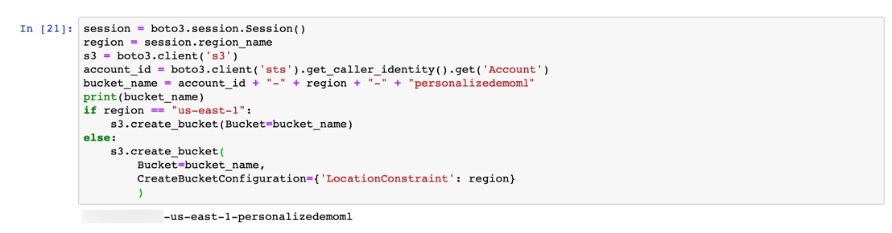
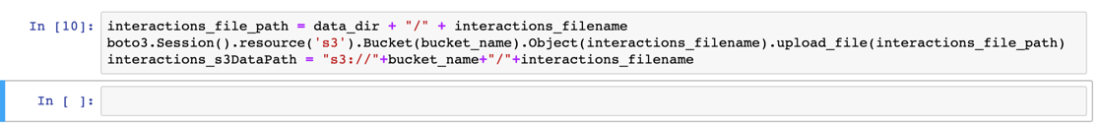
Import dataset
In this part we configure our Amazon S3 bucket and import the data into the program.
Amazon Simple Storage Service (Amazon S3) is an object storage service that offers industryleading scalability, data availability, security, and performance.
In this module, we created an Amazon S3 bucket to stage our interactions dataset.
To ensure that Amazon Personalize can access and work with our data, we also grant different permissions using IAM roles and policies of aws.

Slide 16
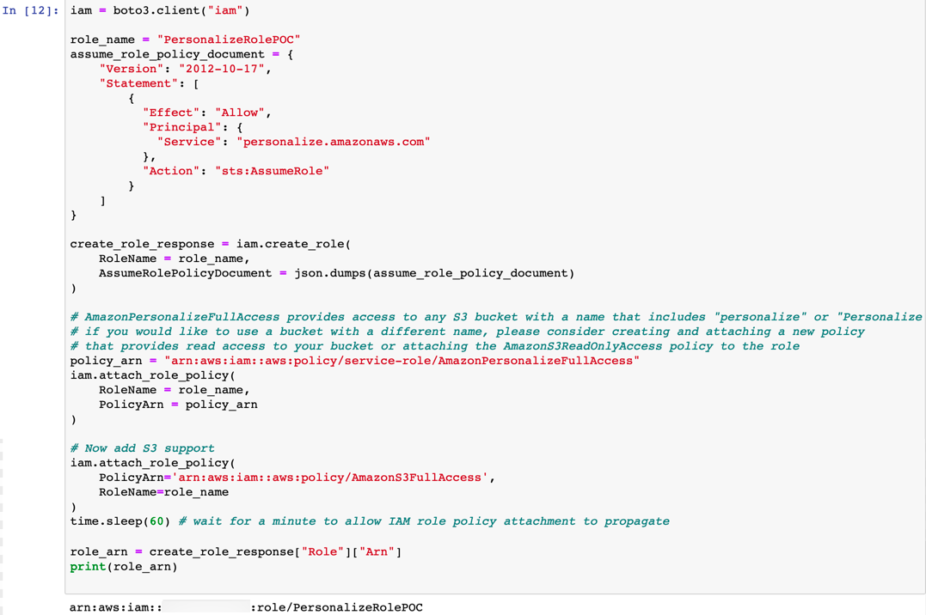
Configuring S3 bucket Policy

Slide 17
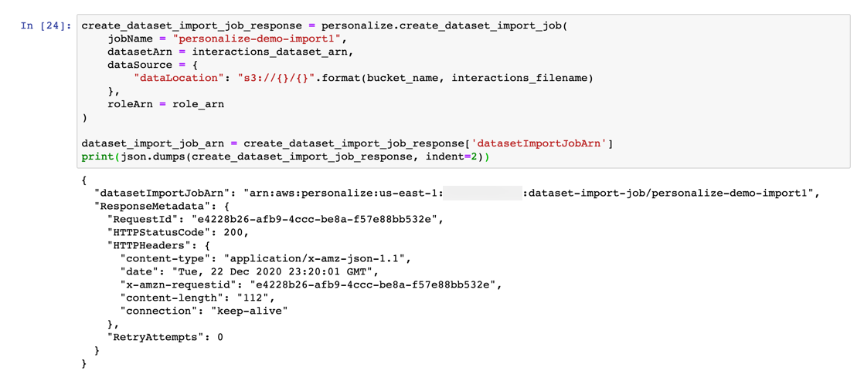
Importing the Dataset in Amazon Personalize

Slide 18
Create and evaluate a solution
In this part, we create an Amazon Personalize solution.
This solution refers to the combination of an Amazon Personalize recipe, customized parameters, and one or more solution versions (trained models).
We create a solution with a solution version, and then create a campaign to deploy the solution version and get recommendations.
Amazon Personalize provides three types of recipes, but in this project, we only use the User_Personalization recipe.

Slide 19
Create a campaign and get recommendations for users
A campaign is used to make recommendations for our users.
In this part, we created a campaign by deploying our solution version.
To deploy a solution version, we have created a campaign in the console or by calling the CreateCampaign API and then we will choose the version of the solution to use.
We have created the campaign and wait for the campaign status to be active.
Then, we use our campaign to get real-time movie title recommendations for users from Amazon Personalize.

Slide 20
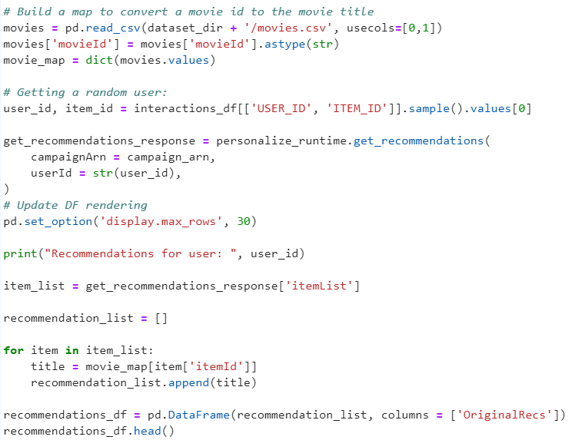
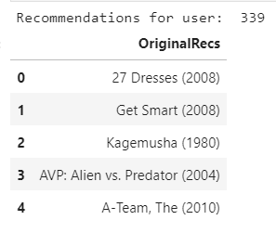
Results
Here is the shown result for user number 339, recommended movies for user 339 are shown here.

Slide 21
Conclusion
So here using Amazon Personalize we have created a real-time personalized movie recommendations in AWS.
We created the Amazon S3 bucket to stage your dataset, created the appropriate policies and roles for Amazon Personalize to access the data, then created an import job to import the data into Amazon Personalize.
We evaluated the solution version for model performance and created a campaign by deploying our solution version.
Finally, We used our campaign to get movie title recommendations for a random user with Amazon Personalize.

Slide 22
Thank YOU

